Slide 1
Introduction to Scientific Programing – Python Day 2
Introduction to Python
Ass-Prof. Iva Pritišanac, PhD
Daniel Platero-Rochart, MSc
Ðesika Kolarić, MSc

Slide 2
Introduction to Python
Python
History, overview, versatility of use
Yesterday (Monday)
Session I (9:30–11:30): Getting Started with Python and Jupyter Notebooks – Variables & Data types, I/O, Conditionals, Loops
Session II (12:30–15:00): Lists, Functions, Error Handling
Today (Tuesday)
Session I (9:00–11:30): File I/O, Working with Libraries (NumPy)
Session II (12:30–15:00):
Data Analysis with Python – Pandas & Matplotlib

Slide 3
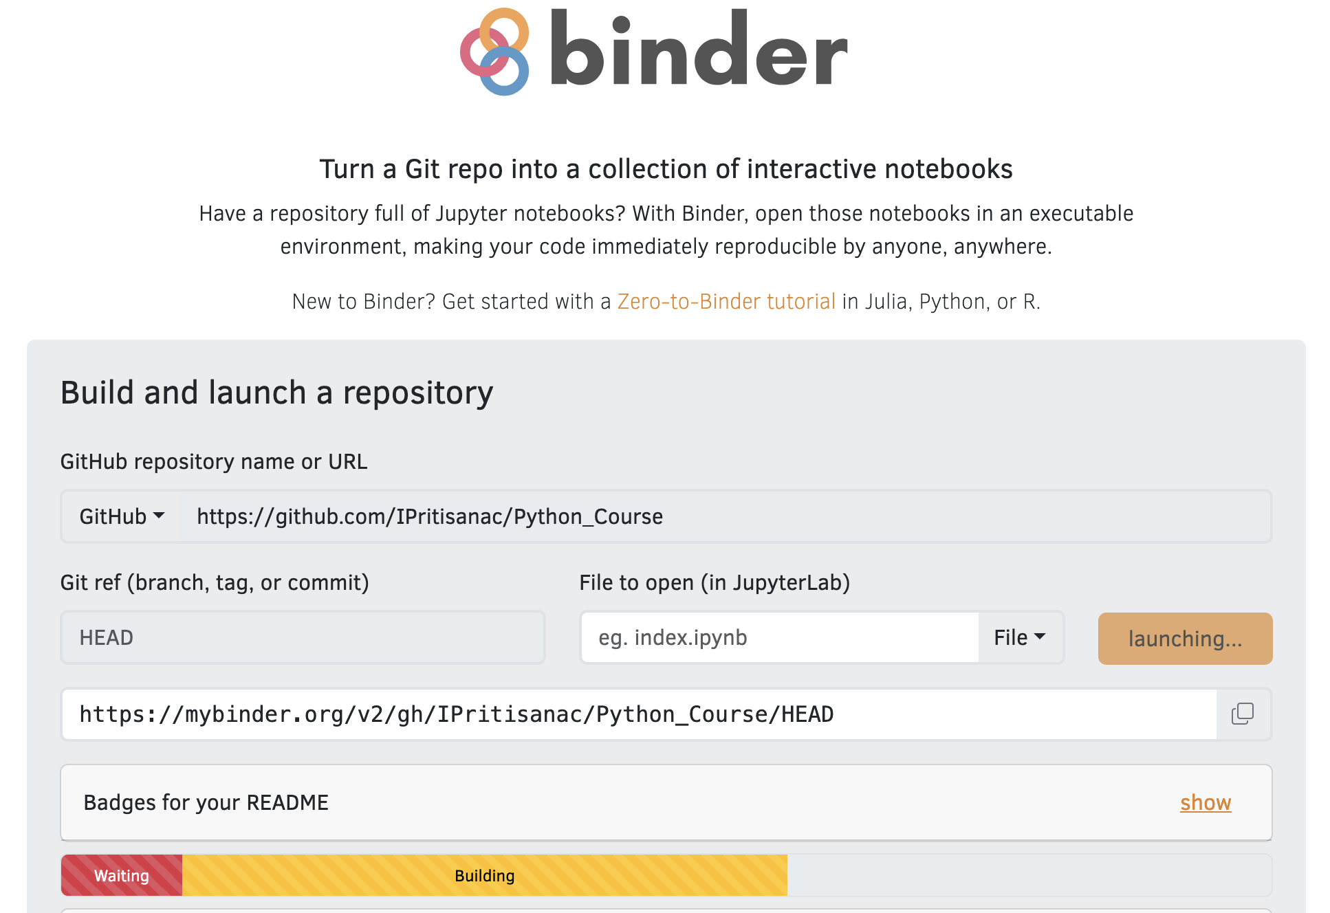
https://github.com/IPritisanac/Python_Course

Slide 4
https://github.com/IPritisanac/Python_Course

Slide 5


File I/O | Hands on
Reading a File:
with open("file.txt", "r") as f:
print(f.read())
Writing to a File:
with open("file.txt", "w") as f:
f.write("Hello, Python!")
fin=open(“file.txt”,”r”)
for line in fin:
print(line)
Notes:
File handling-- writing and reading files

Slide 6

File I/O | Hands on
Reading a File:
with open("file.txt", "r") as f:
print(f.read())
Writing to a File:
with open("file.txt", "w") as f:
f.write("Hello, Python!")
Note: Appending to a file ”a”
fin=open(“file.txt”,”r”)
cnt_l=1
for line in fin:
cnt_l+=1
print(f"Content of line {cnt_l}: {line.strip()}")

Slide 7
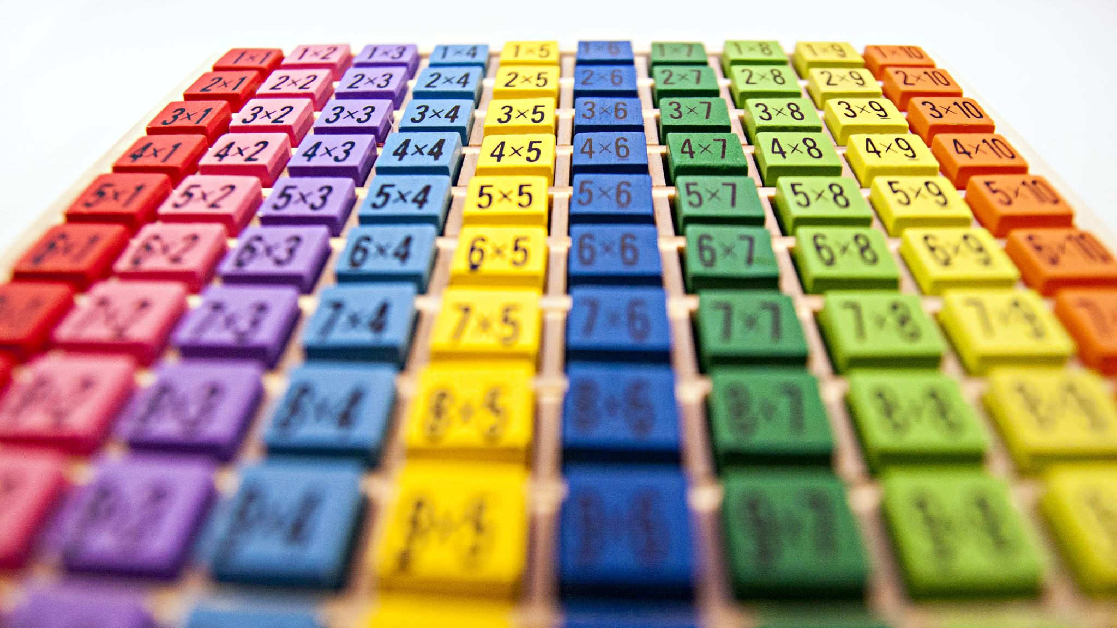

NumPy –Numerical Python
NumPy: Python library for numerical computations
Contains methods (i.e., code) for:
- Assigning (multi-dimensional) arrays `ndarray`
- Mathematical operations on arrays (e.g., additions, multiplication)
- Efficient data handling and manipulation
NumPy Documentation(https://numpy.org/doc/)

Slide 8
NumPy –Basics
import numpy as np
array = np.array([1, 2, 3, 4, 5])
print(array[1])
print(array.mean())
print(array.amax())

Slide 9
More np arrays!
import numpy as np
# 1D array
array_1d = np.array([1, 2, 3, 4])
# Creating 2D array
array_2d = np.array([[1, 2], [3, 4]])

Slide 10
More np arrays!
import numpy as np
# 1D array
array_1d = np.array([1, 2, 3, 4])
# Creating 2D array
array_2d = np.array([[1, 2], [3, 4]])
# Creating nd array of zeros
zeros = np.zeros((2, 3))

Slide 11
More np arrays!
import numpy as np
# 1D array
array_1d = np.array([1, 2, 3, 4])
# Creating 2D array
array_2d = np.array([[1, 2], [3, 4]])
# Creating nd array of zeros
zeros = np.zeros((2, 3))
# Creating nd array of ones
ones = np.ones((2, 3))

Slide 12
More np arrays!
import numpy as np
# 1D array
array_1d = np.array([1, 2, 3, 4])
# Creating 2D array
array_2d = np.array([[1, 2], [3, 4]])
# Creating nd array of zeros
zeros = np.zeros((2, 3))
# Creating nd array of ones
ones = np.ones((2, 3))
# Array with a range of numbers
range_array = np.arange(0, 10, 2)

Slide 13
Array Indexing and Slicing
# 1D Indexing
print(array_1d[0]) # Access the first element
# 2D Indexing
print(array_2d[0, 1]) # Access the element in row 0, column 1
# Slicing
print(array_1d[1:3]) # Slice elements from index 1 to 2
print(array_2d[:, 1]) # Select all rows, column 1
Indexing Documentation:
https://numpy.org/doc/stable/user/basics.indexing.html

Slide 14
Creating Arrays
Task:
Create a 1D array containing the first 10 even numbers
Create a 3x3 array filled with the number 7

Slide 15

Creating Arrays
Task:
Create a 1D array containing the first 10 even numbers
Create a 3x3 array filled with the number 7
Challenge:
Create a 3x3 identity matrix (diagonal of 1s, all other elements 0).

Slide 16
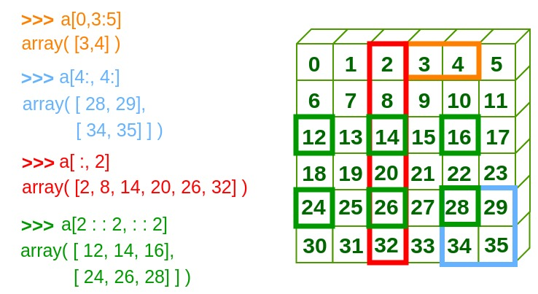
Array Indexing and Slicing
0 | 1 | 2 | 3 | 4 | 5
6 | 7 | 8 | 9 | 10 | 11
12 | 13 | 14 | 15 | 16 | 17
18 | 19 | 20 | 21 | 22 | 23
24 | 25 | 26 | 27 | 28 | 29
30 | 31 | 32 | 33 | 34 | 35

Slide 17
Array Indexing and Slicing
Source
https://www.geeksforgeeks.org/numpy-indexing/

Slide 18
Indexing and Slicing
Task
Create a 4x4 array with values ranging from 1 to 16
Extract the second row and third column

Slide 19
Indexing and Slicing
Task
Create a 4x4 array with values ranging from 1 to 16
Extract the second row and third column
Challenge
Extract all elements from the last two rows and first two columns of the 4x4 array

Slide 20
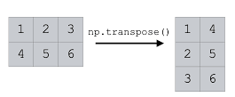
Array Manipulations
Reshape
reshaped = np.arange(6).reshape(2, 3)
print(reshaped)
Transpose
transposed = reshaped.T
print(transposed)
Flatten
flattened = reshaped.flatten()
Documentation https://numpy.org/doc/stable/reference/routines.array-manipulation.html

Slide 21
Array Manipulations
Task
Create an array of shape (3, 6) with values from 0 to 17. Reshape it into (6, 3) and print the result

Slide 22
Array Manipulations
Task
Create an array of shape (3, 6) with values from 0 to 17. Reshape it into (6, 3) and print the result
Challenge:
Flatten the reshaped array and compute its mean, minimum, and maximum values.

Slide 23
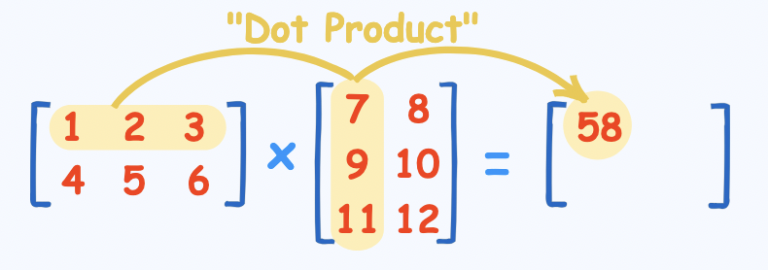
Matrix Multiplication
matrix1 = np.array([[1, 2 ], [4, 5]])
matrix2 = np.array([[7, 8], [10, 11]])
result = np.dot(matrix1, matrix2)
print(result)
Source
https://www.mathsisfun.com/algebra/matrix-multiplying.html

Slide 24
Matrix Multiplication
Task
Multiply a 2x3 matrix by a 3x2 matrix and print the resulting 2x2 matrix

Slide 25
Matrix Multiplication
Task
Multiply a 2x3 matrix by a 3x2 matrix and print the resulting 2x2 matrix
Challenge
Write a matrix multiplication function from scratch
Verify the result of the matrix multiplication manually (i.e., calculate by hand) and compare with NumPy's result

Slide 26
Boolean Logic on Arrays
array = np.array([1, 2, 3, 4, 5])
# Boolean indexing
print(array[array > 2]) # Elements greater than 2
# Logical operations
print((array > 2) & (array < 5)) # Logical AND
print((array < 3) | (array > 4)) # Logical OR
https://numpy.org/doc/stable/reference/arrays.indexing.html#boolean-array-indexing

Slide 27
Boolean Logic on Arrays
Task
Given an array of numbers from 1 to 20, extract only the even numbers using Boolean indexing

Slide 28
Boolean Logic on Arrays
Task
Given an array of numbers from 1 to 20, extract only the even numbers using Boolean indexing
Challenge
Given an array of numbers, replace all numbers greater than 10 with 0 (hint: np.where())

Slide 29
Introduction to Python
BREAK
Session II (12:30–15:00):
Data Analysis with Python – Pandas & Matplotlib

Slide 30
Numpy (More Tasks!)
Task:
Create a 5x5 array with random integers between 1 and 50.
Find:
The maximum value in each row.
The minimum value in each column.
Challenge
Normalize the array (scale all values to be between 0 and 1)

Slide 31


Data Analysis : Pandas
DataFrame Basics:
import pandas as pd
data = {"Name": ["Anna", "Bob"], "Age": [25, 30]}
df = pd.DataFrame(data)
print(df)
Notes:
Create and manipulate data using Pandas DataFrames

Slide 32
Data Analysis : Pandas
DataFrame Basics:
import pandas as pd
data = {"Name": ["Anna", "Bob"], "Age": [25, 30]}
df = pd.DataFrame(data)
print(df)
Notes:
Create and manipulate data using Pandas DataFrames

Slide 33
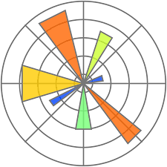
Data Analysis : Matplotlib
import matplotlib.pyplot as plt
plt.plot([1, 2, 3], [4, 5, 6])
plt.show()
Notes:
Basic plotting with Matplotlib
Here -- a simple line plot

Slide 34

Further Resources:
https://developers.google.com/edu/python - Google’s 2-day Python Course
Automate the boring stuff with Python. Practical Programming for total beginners. Al Sweigart.
Learning Python. Fabrizio Romano.
The Python Workbook. A brief introduction with exercises and solutions. Ben Stephenson.
https://wiki.python.org/moin/BeginnersGuide/NonProgrammers

Slide 35


Further Resources:
Automate the boring stuff with Python. Practical Programming for total beginners. Al Sweigart.
Learning Python. Fabrizio Romano.
The Python Workbook. A brief introduction with exercises and solutions. Ben Stephenson.
https://wiki.python.org/moin/BeginnersGuide/NonProgrammers
REMEMBER: Problem-solving = understanding
Before getting an easy answer, give it your
best try
Embrace challenges—that is how you
learn and grow ☺
ChatGPT

